Slide 1
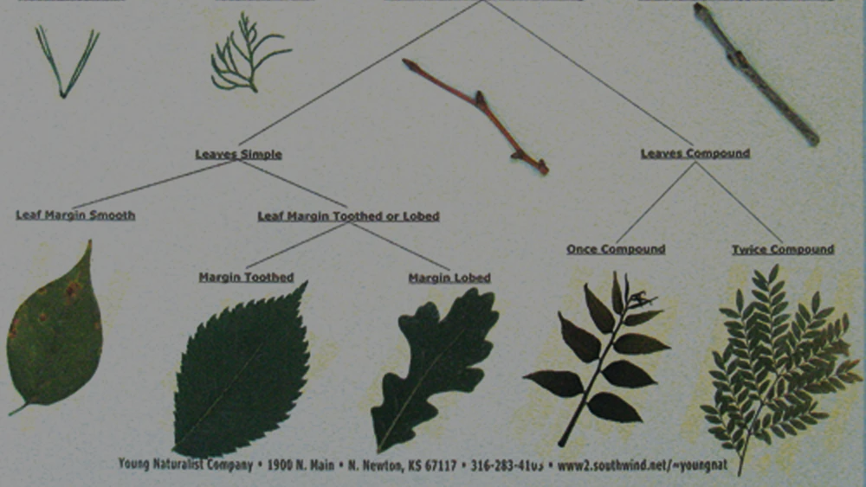
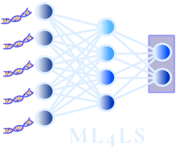


Evaluating plant trait descriptions crawled from the Web
Or towards a plant identification AI that reasons like a botanist
Diego Marcos, Robert van de Vlasakker, Ioannis Athanasiadis
Machine Learning for Life Sciences, Montpellier, 17 Nov 2022
Notes:
Welcome!
A step towards robust species recognition: learning AI to reason like a skilled taxonomist
My name is Robert
My supervisors are Diego and Ioannis.
To start, a small note about the front cover
The front cover is a small joke to make the thesis a bit more MGI related.
It contains the most common bird traits from the 512 birds present in the Netherlands.
The sizes of the words, indicate the overall occurence of the trait.
There are some obvious mistakes, as covert great, ovbious refers to the greater covert of birds
And not that birds in the Netherlands have great coverts
But it is possible to map the most common traits to an certain area.
But lets start

Slide 2
Content
Intro
Why we need semantic bottlenecks in deep learning
Species ID as the ideal case study
Preliminary results
Future work
Notes:
First a little bit of back ground information
This is a classic convultion neural network
It takes in an image, and classifies the images.
Classic Convolution Neural nets give good accuracy,
but are like black boxes: it is unclear how predictions are made.
And it is unclear how new new species should be handeld,
as the regular CNN can only predict seen species.

Slide 3
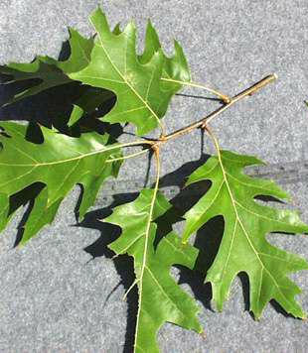
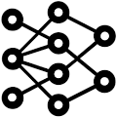
A classical CNN
Intro
40% Quercus rubra
27% Quercus ilex
...
Notes:
First a little bit of back ground information
This is a classic convultion neural network
It takes in an image, and classifies the images.
Classic Convolution Neural nets give good accuracy,
but are like black boxes: it is unclear how predictions are made.
And it is unclear how new new species should be handeld,
as the regular CNN can only predict seen species.

Slide 4
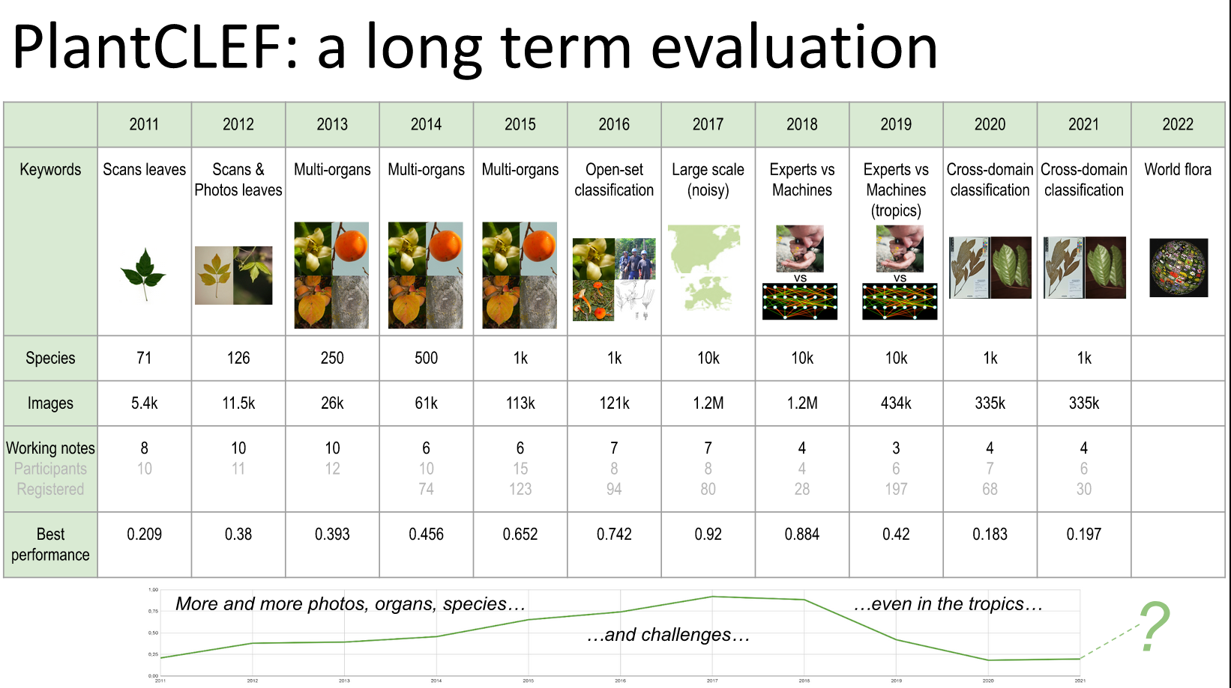
Slide shamelessly stolen from Pl@ntNet’s Hervé Goëau

Slide 5
A classical CNN
Intro
How to handle new species?
Black Box
40% Quercus rubra
27% Quercus ilex
...
Notes:
First a little bit of back ground information
This is a classic convultion neural network
It takes in an image, and classifies the images.
Classic Convolution Neural nets give good accuracy,
but are like black boxes: it is unclear how predictions are made.
And it is unclear how new new species should be handeld,
as the regular CNN can only predict seen species.

Slide 6
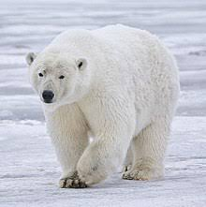
A classical CNN
Intro
Almost sure it’s
a polar bear
Notes:
First a little bit of back ground information
This is a classic convultion neural network
It takes in an image, and classifies the images.
Classic Convolution Neural nets give good accuracy,
but are like black boxes: it is unclear how predictions are made.
And it is unclear how new new species should be handeld,
as the regular CNN can only predict seen species.

Slide 7
Visual-Language Hybrid Model
Intro
The surroundings look white and flat,
Probably ice, but maybe a salt flat.
Almost sure it’s
a polar bear
There is one large object in the middle.
It’s furry, white, with large paws, black nose and eyes
Notes:
First a little bit of back ground information
This is a classic convultion neural network
It takes in an image, and classifies the images.
Classic Convolution Neural nets give good accuracy,
but are like black boxes: it is unclear how predictions are made.
And it is unclear how new new species should be handeld,
as the regular CNN can only predict seen species.

Slide 8
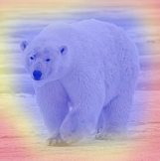
A classical CNN
Intro
Almost sure it’s
a polar bear
Notes:
First a little bit of back ground information
This is a classic convultion neural network
It takes in an image, and classifies the images.
Classic Convolution Neural nets give good accuracy,
but are like black boxes: it is unclear how predictions are made.
And it is unclear how new new species should be handeld,
as the regular CNN can only predict seen species.

Slide 9
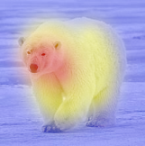
A classical CNN
Intro
Almost sure it’s
a polar bear
Notes:
First a little bit of back ground information
This is a classic convultion neural network
It takes in an image, and classifies the images.
Classic Convolution Neural nets give good accuracy,
but are like black boxes: it is unclear how predictions are made.
And it is unclear how new new species should be handeld,
as the regular CNN can only predict seen species.

Slide 10
A classical CNN
Intro
Almost sure it’s
a Grizzly bear
Notes:
First a little bit of back ground information
This is a classic convultion neural network
It takes in an image, and classifies the images.
Classic Convolution Neural nets give good accuracy,
but are like black boxes: it is unclear how predictions are made.
And it is unclear how new new species should be handeld,
as the regular CNN can only predict seen species.

Slide 11
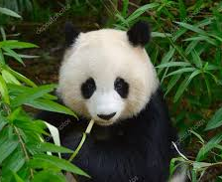
Visual-Language Hybrid Model
Intro
The surroundings look lush, with bamboo.
?
There is one large object in the middle.
It’s furry, black and white, with large paws, black nose, ears and eyes
Notes:
First a little bit of back ground information
This is a classic convultion neural network
It takes in an image, and classifies the images.
Classic Convolution Neural nets give good accuracy,
but are like black boxes: it is unclear how predictions are made.
And it is unclear how new new species should be handeld,
as the regular CNN can only predict seen species.

Slide 12

Zero-shot learning
Intro
Probably a giant panda.
The surroundings look lush, with bamboo.
There is one large object in the middle.
It’s furry, black and white, with large paws, black nose, ears and eyes
Notes:
First a little bit of back ground information
This is a classic convultion neural network
It takes in an image, and classifies the images.
Classic Convolution Neural nets give good accuracy,
but are like black boxes: it is unclear how predictions are made.
And it is unclear how new new species should be handeld,
as the regular CNN can only predict seen species.

Slide 13
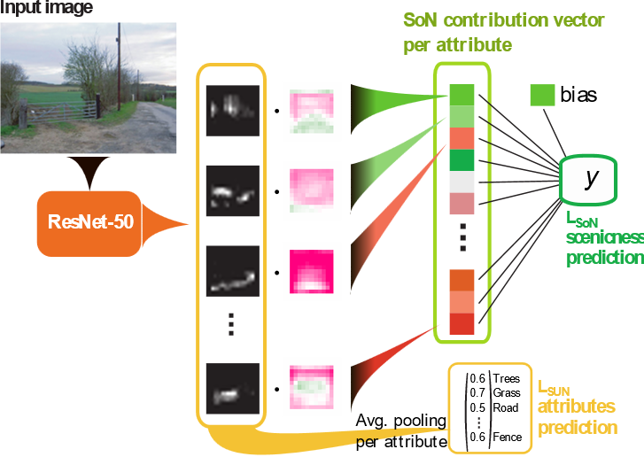
Attribute-based Model
Intro
Limited expressivity due to the linear mapping
Semantically Interpretable Activation Maps: what-where-how explanations within CNNs. D Marcos, S Lobry, D Tuia. ICCVW 2019
Notes:
Diego proposed a new version.
Where a CNN hybrid model taken in an image and tell what it sees.
The Natural Language processing model takes the text and makes a prediction
This way the intermediate results are interpretable as natural language is used.
And this allows for trait sharing making it better suited to detect unknown species.
And I, investigated the NLP part of this project.

Slide 14
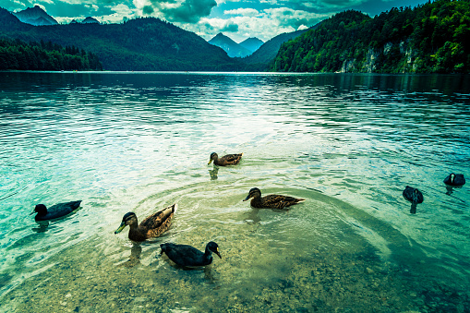
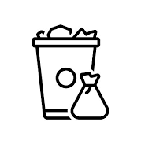





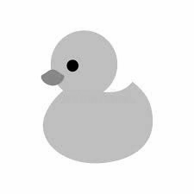



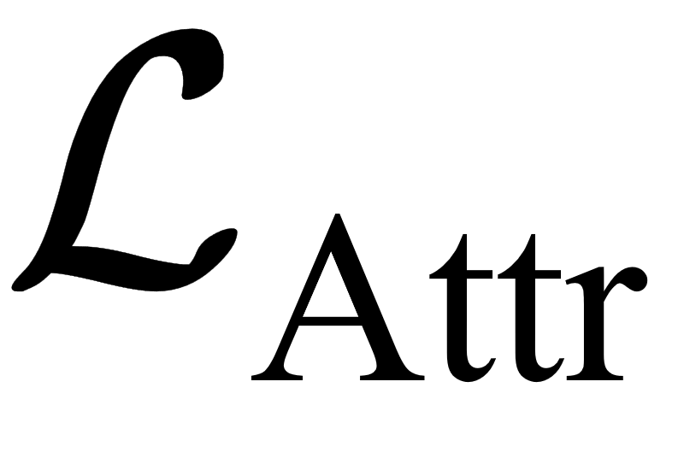
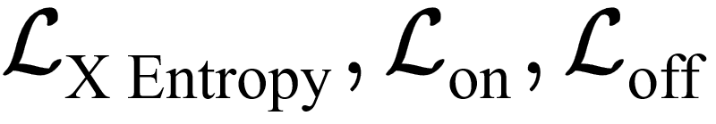


Attribute-based Model
Intro
Deep Neural Network
Still limited due to the chosen attributes
&
&
&
&
-2
+3
+2.5
+1
8/10
+5
average value
Contextual Semantic Interpretability. D Marcos, R Fong, S Lobry, R Flamary, N Courty, D Tuia. ACCV 2020
Notes:
Diego proposed a new version.
Where a CNN hybrid model taken in an image and tell what it sees.
The Natural Language processing model takes the text and makes a prediction
This way the intermediate results are interpretable as natural language is used.
And this allows for trait sharing making it better suited to detect unknown species.
And I, investigated the NLP part of this project.

Slide 15
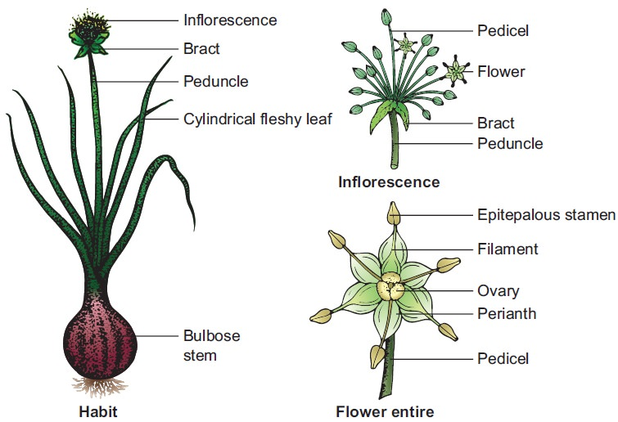
A classical CNN
Intro
Leaf: a cluster of radical leaves emerges from the underground bulb, cylindrical and fleshy having sheathy leaf bases with parallel venation.
Flower: Small, white, bracteate, ebrcteolate, pedicellate, complete, trimerous, actinomorphic and hypogynous. Flowers are protandrous.
Perianth: Tepals 6, white,arranged in two whorls of three each, syntepalous showing valvate aestivation.
And so on and so forth with botanical terms.
https://www.brainkart.com/article/Botanical-description-of-Allium-cepa_32996/
Notes:
First a little bit of back ground information
This is a classic convultion neural network
It takes in an image, and classifies the images.
Classic Convolution Neural nets give good accuracy,
but are like black boxes: it is unclear how predictions are made.
And it is unclear how new new species should be handeld,
as the regular CNN can only predict seen species.

Slide 16
Visual-Language Hybrid Model
Intro
+ Interpretability
+ Zero-shot and few-shot learning
Simple leaves
Alternate leaves
Toothed lobes
Sharp lobes
Lustrous leaves
40% Q. rubra
27% Q. ilex
...
Notes:
Diego proposed a new version.
Where a CNN hybrid model taken in an image and tell what it sees.
The Natural Language processing model takes the text and makes a prediction
This way the intermediate results are interpretable as natural language is used.
And this allows for trait sharing making it better suited to detect unknown species.
And I, investigated the NLP part of this project.

Slide 17
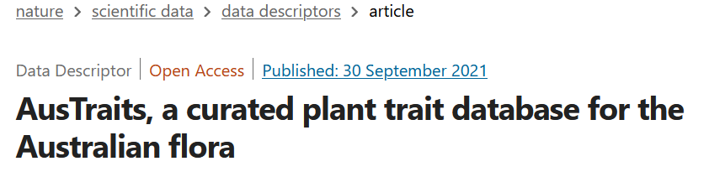
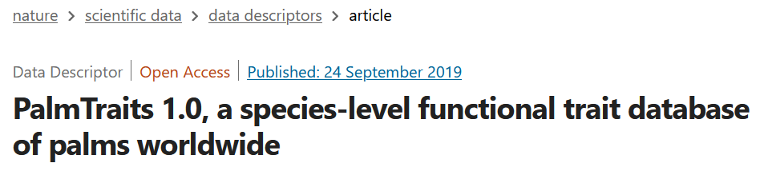
Morphological trait databases
Where to get data
Existing morphological trait databases tend to be limited in scope in terms of geography or taxonomic group and are rigid.
Notes:
Diego proposed a new version.
Where a CNN hybrid model taken in an image and tell what it sees.
The Natural Language processing model takes the text and makes a prediction
This way the intermediate results are interpretable as natural language is used.
And this allows for trait sharing making it better suited to detect unknown species.
And I, investigated the NLP part of this project.

Slide 18
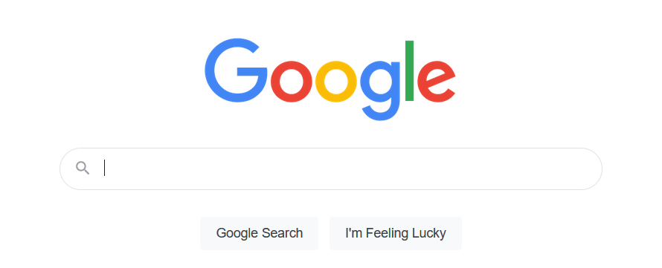
The World Wide Web
Where to get data
Notes:
Diego proposed a new version.
Where a CNN hybrid model taken in an image and tell what it sees.
The Natural Language processing model takes the text and makes a prediction
This way the intermediate results are interpretable as natural language is used.
And this allows for trait sharing making it better suited to detect unknown species.
And I, investigated the NLP part of this project.

Slide 19
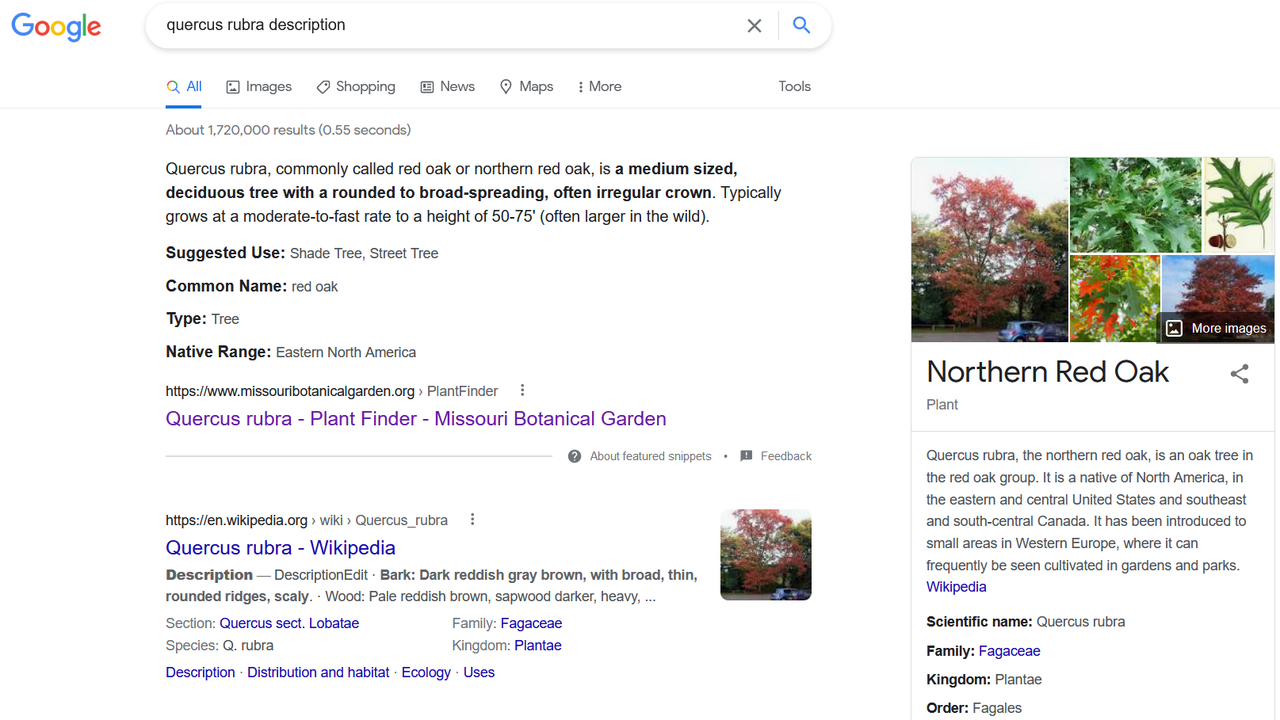
Notes:
I formulated the following research questions for this problem
How can a high-quality database be automatically created containing species names and a combination of unique descriptions per species?
We need a large database to train the NLP model
Which interpretation techniques can be used with the descriptive sentences to extract the most relevant traits for a species?
Extract the most relevant information from a sentence, to have trait overlap.
Sentences contain irrelevant information are unique
Simpler trait might be a solution
How should a deep learning model be built, trained and evaluated to predict existing species with natural language?
How should the data be used for a model so a model can make a prediction based on the text
And keep track of the most important traits

Slide 20

The World Wide Web
Where to get data
Description paragraph from the first page in Google
Notes:
Diego proposed a new version.
Where a CNN hybrid model taken in an image and tell what it sees.
The Natural Language processing model takes the text and makes a prediction
This way the intermediate results are interpretable as natural language is used.
And this allows for trait sharing making it better suited to detect unknown species.
And I, investigated the NLP part of this project.

Slide 21
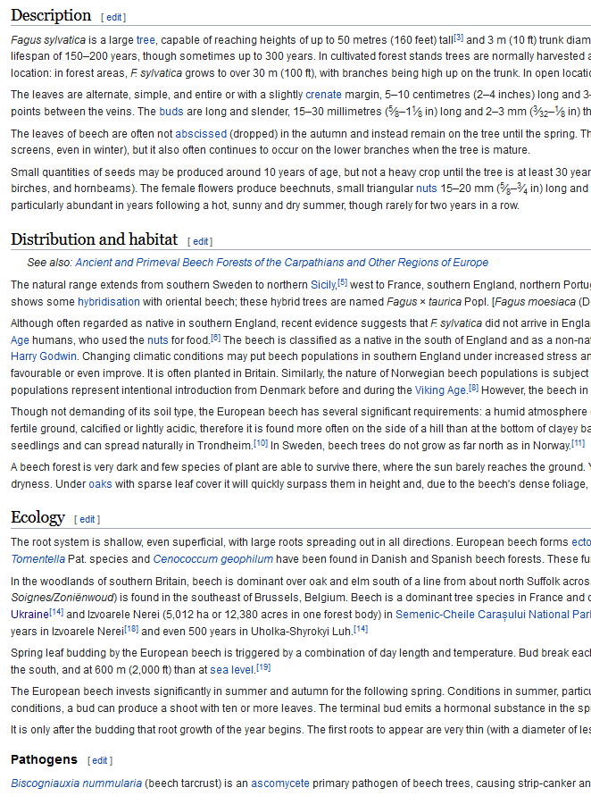
Binary Description Classifier
Where to get data
Used as Positive label: The text DOES contain description information
Used as Negative labels: The text does NOT contain description information
Notes:
Headers with text not about descriptions are used as negative labels
Headers with text about descriptions are used as positive labels
But text is generally noisy, some negative paragraphs have descriptions and vice versa.
I implemented a costum loss that could help deal with the noisiness of the dataset
The basic architercture is a BERT model with a linaer classifier on top of it
BERT is a NLP model that has been trained on a large corpus and is freely available.

Slide 22
The World Wide Web
Where to get data
Trained on 3 structured data sources:
Wikipedia (pages about plants, birds and mammals, enriched with non-organism pages)
Birds of the World (pages about birds)
Plants of the World Online (pages about plants)
Tested on 2 completely left out data sources:
Llifle (pages about plants)
AgroForestry (pages about plants)
Notes:
Diego proposed a new version.
Where a CNN hybrid model taken in an image and tell what it sees.
The Natural Language processing model takes the text and makes a prediction
This way the intermediate results are interpretable as natural language is used.
And this allows for trait sharing making it better suited to detect unknown species.
And I, investigated the NLP part of this project.

Slide 23
The World Wide Web
Where to get data
Over 50,000 species and pages used for training:
10,000 pages from Birds of the World
35,000 pages from Plants of the Worlds Online
5,000 species from Wikipedia
Trained on a total of more than 2,25 million samples:
About 1,7 millions that corresponds to non-description text
About 550,000 samples correspond to descriptive text
Notes:
Diego proposed a new version.
Where a CNN hybrid model taken in an image and tell what it sees.
The Natural Language processing model takes the text and makes a prediction
This way the intermediate results are interpretable as natural language is used.
And this allows for trait sharing making it better suited to detect unknown species.
And I, investigated the NLP part of this project.

Slide 24
Model Performance
Test Datset
Held-out Datasets
Notes:
The resuts of the description classifier!
Left the results of the test set, for this dataset 20% of all data is used.
Right the results of 2 completely left out dataset, You see that the model performs worse on this dataset.
This could be also because the data is also noisy and the model cannot correct for this.
The datasets are contstructed the same way, using the header to give the samples a negative or a positive label.

Slide 25
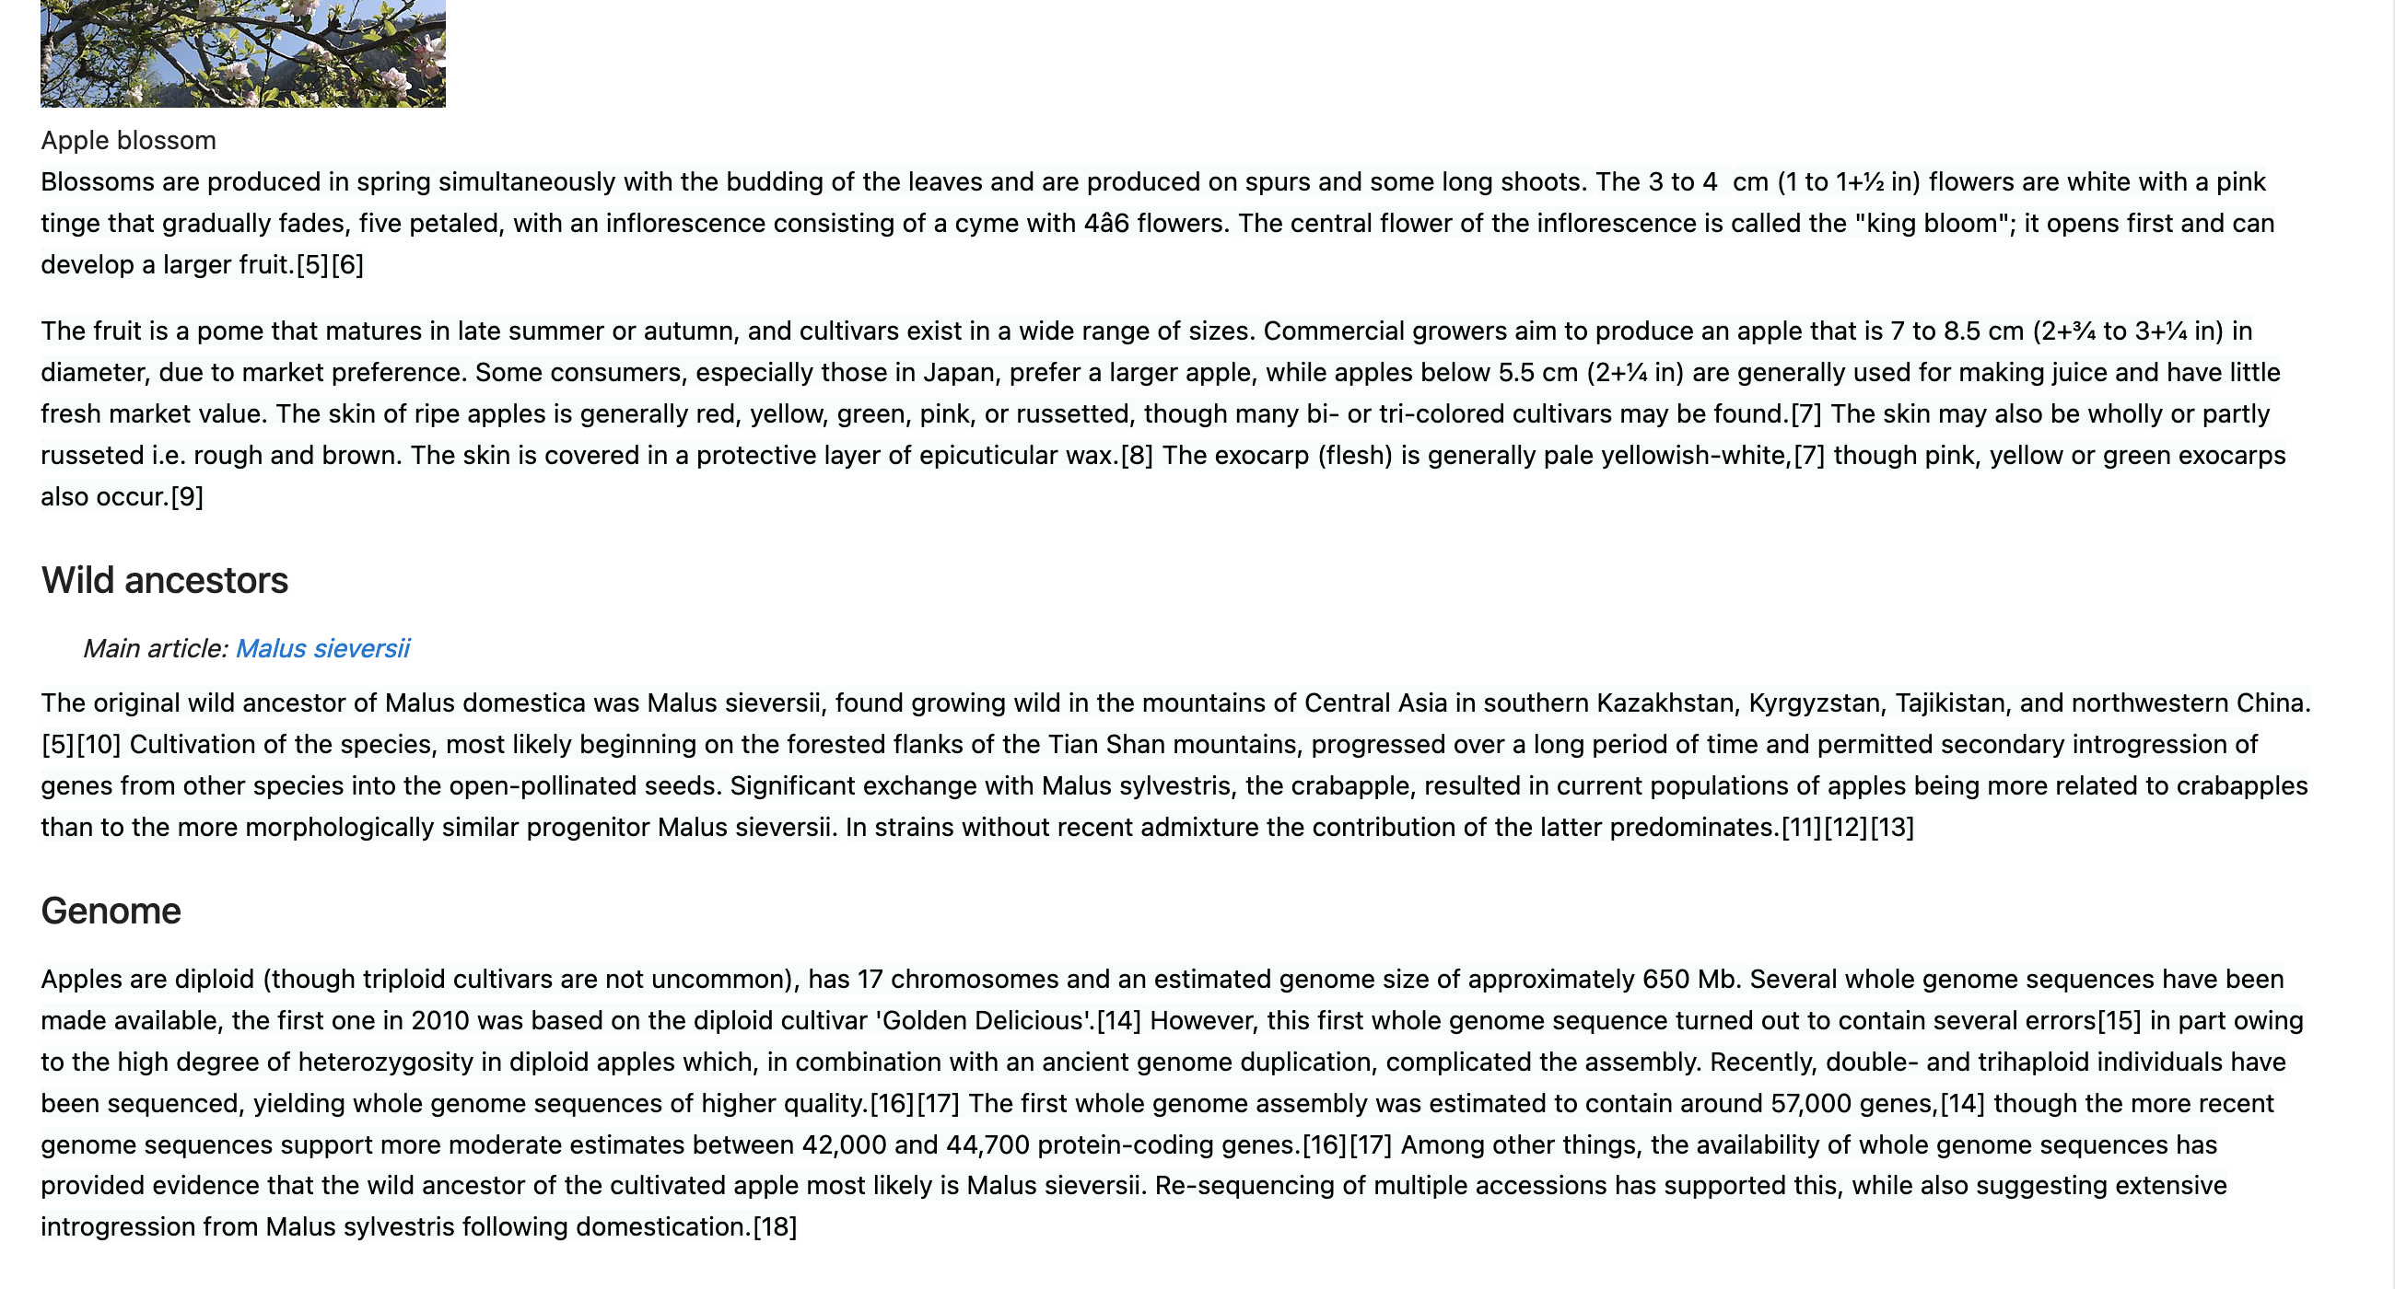
Notes:
And now the classifier in practice!
This is a wikipedia page about apples
It is deployed in a web crawler.
The crawler queries the page
and breaks the text down into sentences.

Slide 26
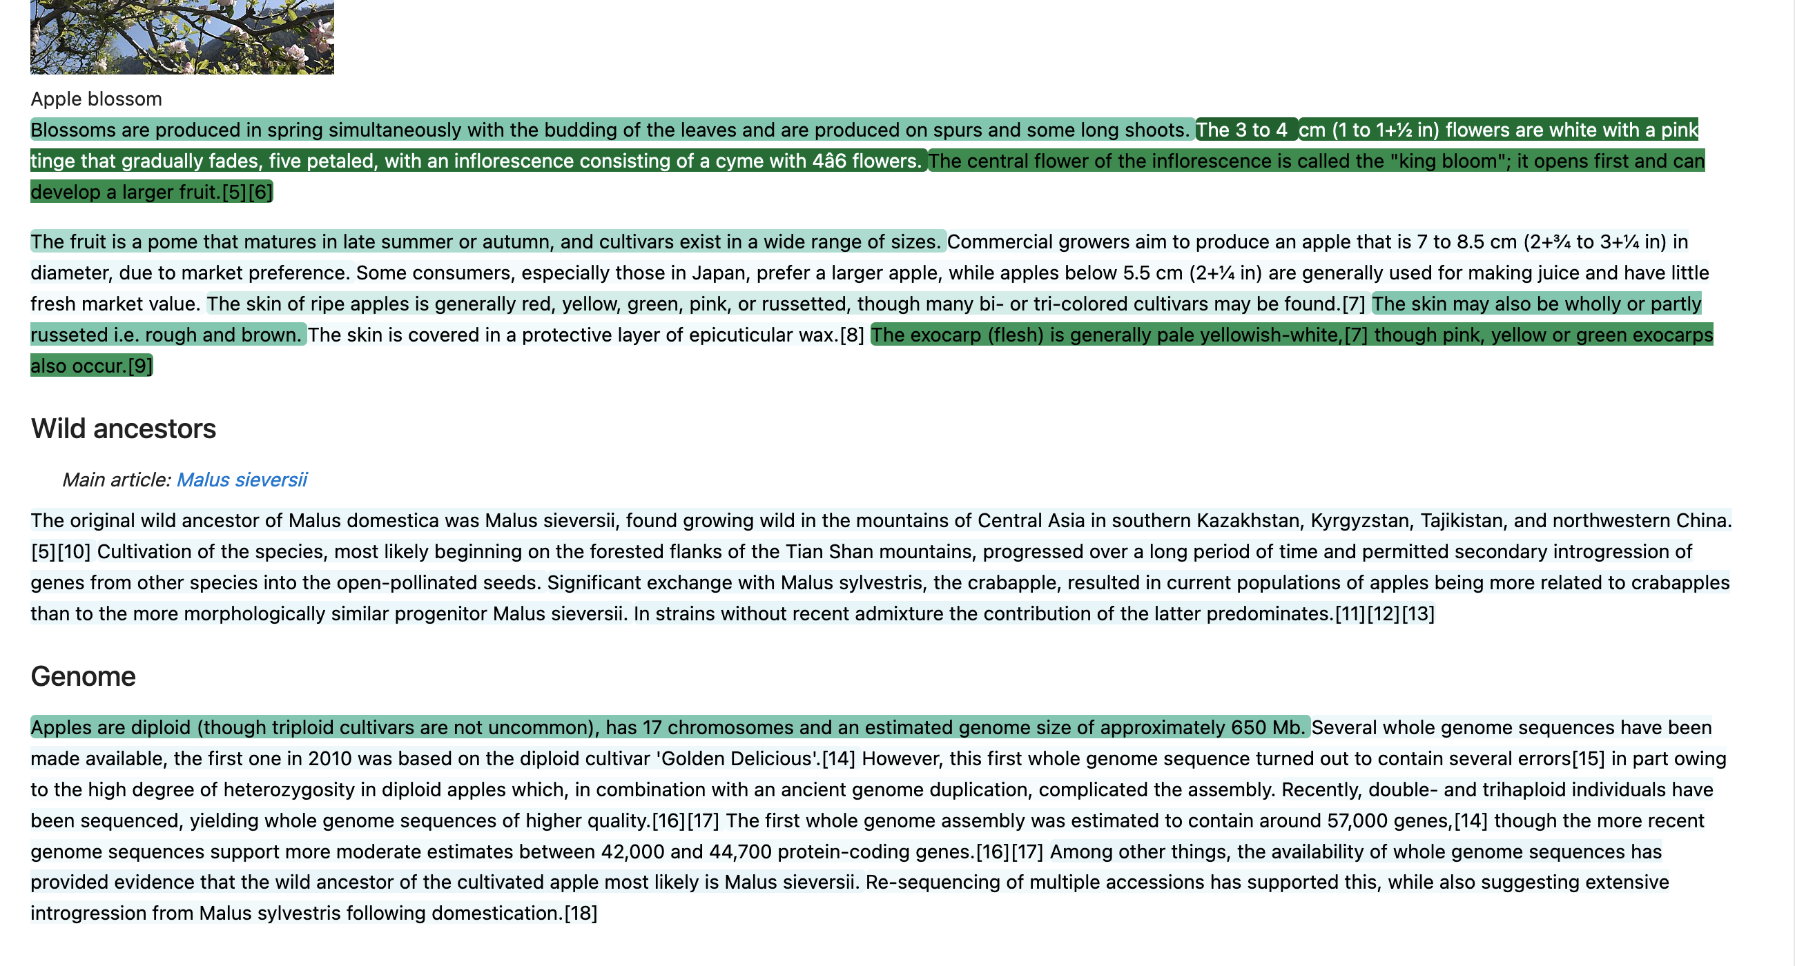
Notes:
Each sentences is classified. In this the darker the green the higher the prediction value.
In this case only sentences with a value above 0.5 are coloured.
And during the crawling these sentence are also saved.

Slide 27
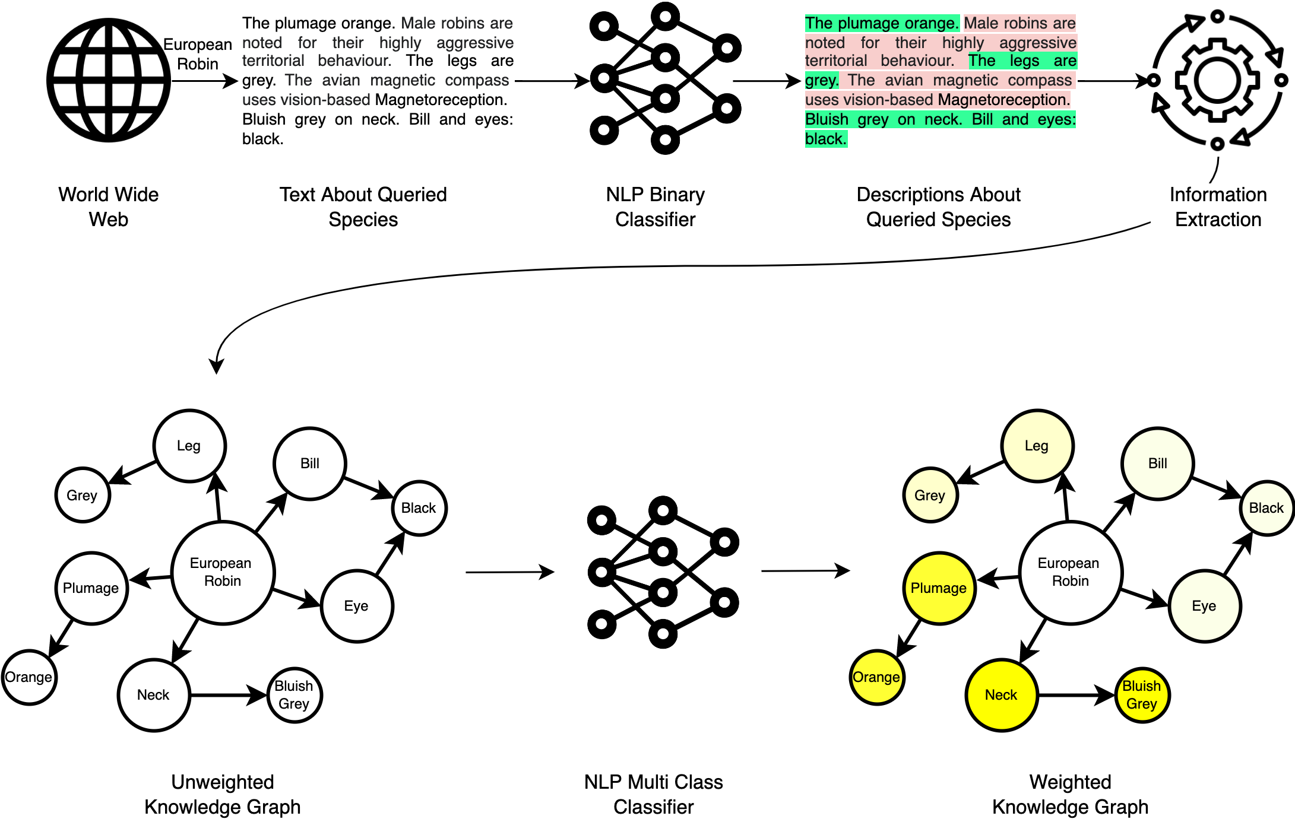
Workflow
Notes:
The second part was to extract the most relevant traits
From the sentences

Slide 28
Workflow
Notes:
The second part was to extract the most relevant traits
From the sentences

Slide 29
Part-of-Speech Tagging
Workflow
“The Red oak has a straight trunk.”
“The trunk is covered by striped bark.”
is
has
Straight
is
has
Red oak
Trunk
Striped
Bark
Notes:
The second part was to extract the most relevant traits
From the sentences

Slide 30
Part-of-Speech Tagging
Workflow
is
has
Straight
is
has
Red oak
Trunk
Striped
Bark
“Red oak has trunk. Trunk is straight”
“Red oak has trunk. Trunk has bark. Bark is striped.”
Notes:
The second part was to extract the most relevant traits
From the sentences

Slide 31
Part-of-Speech Tagging
Workflow
Does this solve potential copyright issues if the dataset is published?
Copyright protection for factual works is narrow, covering the author's original expressions, but not the facts or theories being expressed. In order to infringe, the copy must be "verbatim reproduction or very close paraphrasing“.
Nonfiction literary works, such as history books, newspaper articles, and biographies, are treated as factual works with similarly narrow copyright protection. An author's unique expressions are protected, but not the facts and theories themselves. Even the selection and arrangement of facts may not be protectable.
Notes:
The second part was to extract the most relevant traits
From the sentences

Slide 32
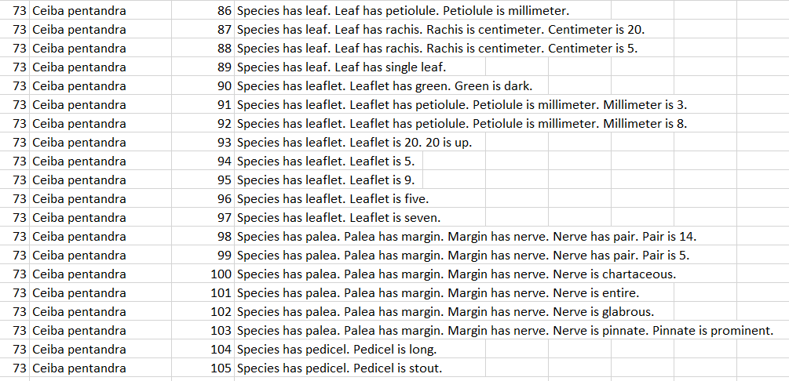
Part-of-Speech Tagging
Workflow
Notes:
The second part was to extract the most relevant traits
From the sentences

Slide 33
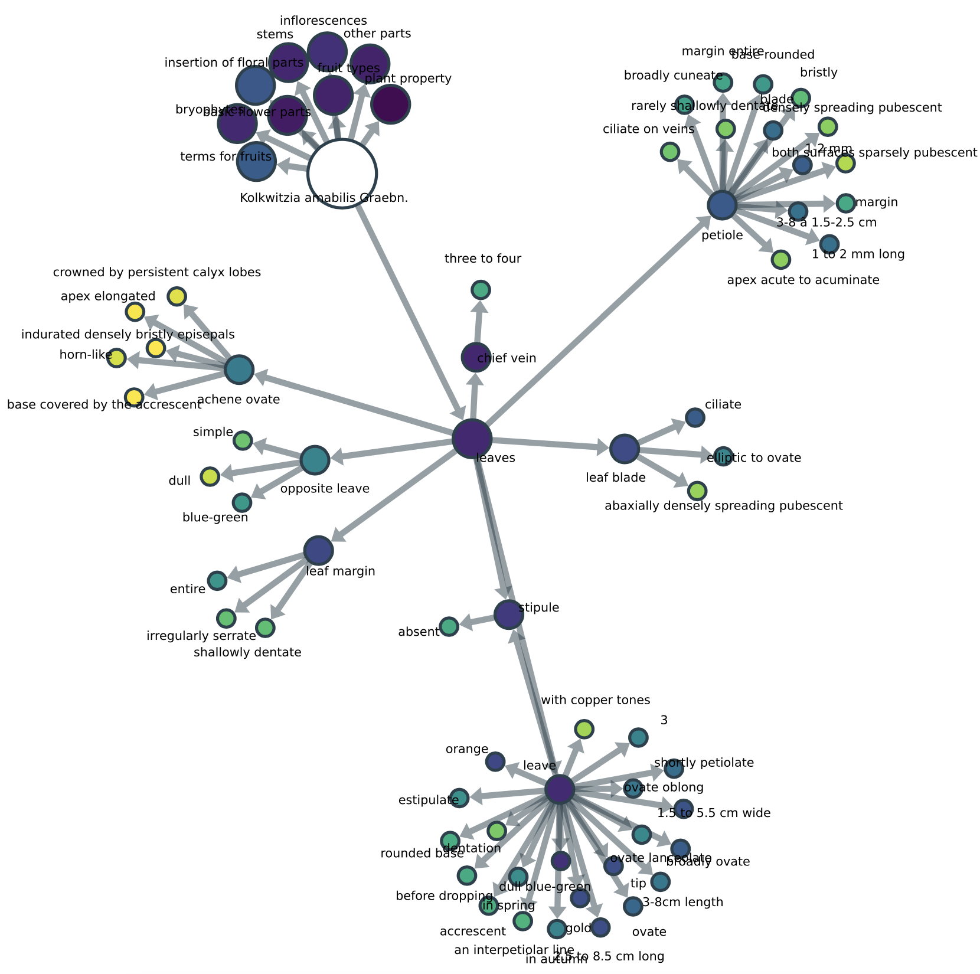
In graph form
Notes:
Here are some basic comparison metrics.
Most precision of the binary variables are not that interesting, as most palms are NOT climbing and for example NOT armed, resulting in very good recall and precision values.
The recall of stem Erect and Solitary is pretty decent, it finds something about the stem 50% of the time.

Slide 34
Manual traits
Evaluation
How do these compare to manually curated databases?
PalmTraits (Species>2000, Daniel Kissling et al.)
  Fruit length • stem length • plant height • petiole length • fruit color • leaf length • plant trait • fruit morphology trait
African trees and shrubs (Species=360, Pierre Bonnet et al.)
  Life form • Leaf apex • venation • spine number and shape • color of leaf, fruit and petals • inflorescence
Dutch Caribbean plants (Species=43, Andre van Proosdij)
  24 morphological traits
Notes:
The second part was to extract the most relevant traits
From the sentences

Slide 35
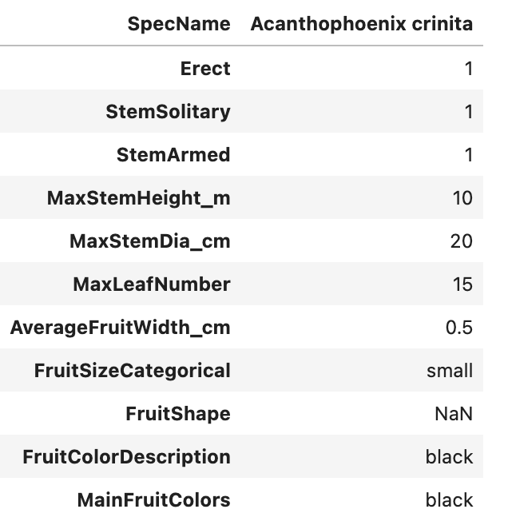
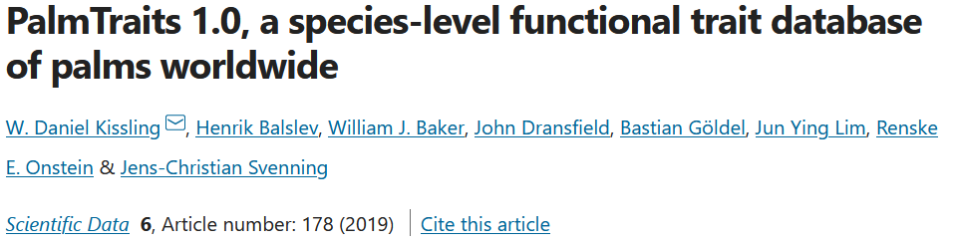
Part-of-Speech Tagging
Workflow
How do these compare to manually curated databases?
Notes:
The second part was to extract the most relevant traits
From the sentences

Slide 36
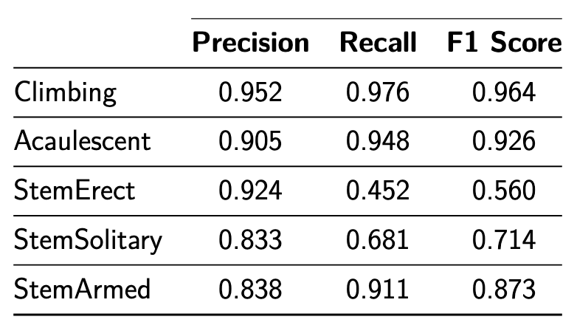
Palm Trait Dataset
Binary Class Variables
Notes:
Here are some basic comparison metrics.
Most precision of the binary variables are not that interesting, as most palms are NOT climbing and for example NOT armed, resulting in very good recall and precision values.
The recall of stem Erect and Solitary is pretty decent, it finds something about the stem 50% of the time.

Slide 37
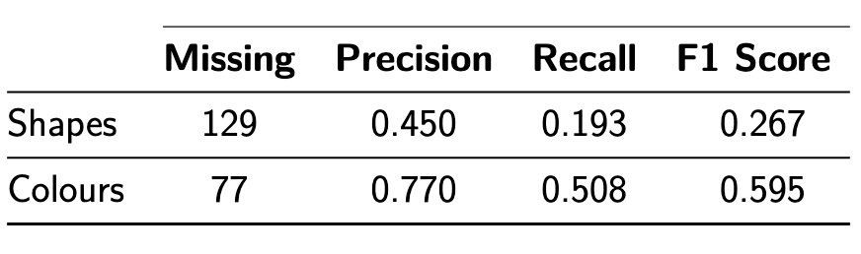
Multi Class
Variables
Fruit Shapes
Notes:
Here you see a confusion matrix of the actual shapes against the shaped the AI system found.
Not for all species a shape is found.
The F1 score is not really high

Slide 38
Multi Class
Variables
Colors
Notes:
It work much better in the case of colours.
There are of course still missing values,
But for the species it does find a colour, it works reasonably well!

Slide 39
Palm Trait Dataset
Numerical Values
Notes:
Here you see the comparison against numerical values.
For each palm you see the found value compared against that of the Palm tree dataset
A dashed line indicates a missing value (we did not found anythign).
And small triangles indicate that the value was higher or lower that 25% of the actual value
I case of simple traits like stem height and diameter, there are quite a few hits

Slide 40
Notes:
however as traits become more specific the error rate is much larger
In case of the fruites is does not looks that good.
In this case it is also difficicult, actually almost impossible to determine if a value belongs to the average, minimal or maximal fruit length.
I suspect average length, as most websites talk about a single lengths and in that case the average length makes the most sense.

Slide 41
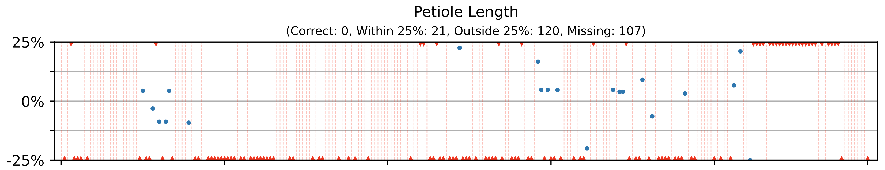
Notes:
In this case you can clearly see that more correct information is extracted for a simple trait like number of leaves.
Than a more difficult trait like petiole length
Most website do contain some information about the number of leaves and colours. and not about the petiole lenght

Slide 42
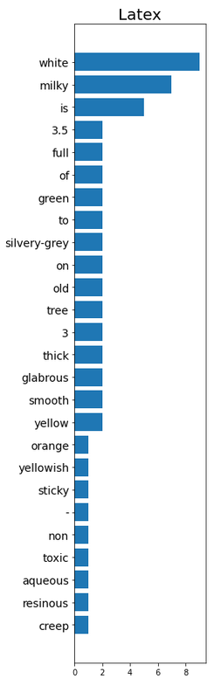
Pierre’s dataset of 360 African trees/bushes and 137 traits
Latex in the hand-crafted dataset:
No exudate
Clear latex
Clear gum or resin
White latex
Yellow latex
Dark gum or resin
Notes:
It work much better in the case of colours.
There are of course still missing values,
But for the species it does find a colour, it works reasonably well!

Slide 43
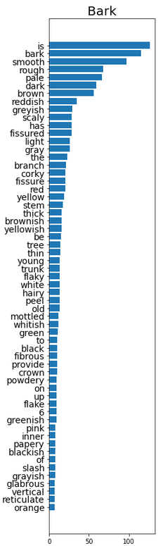
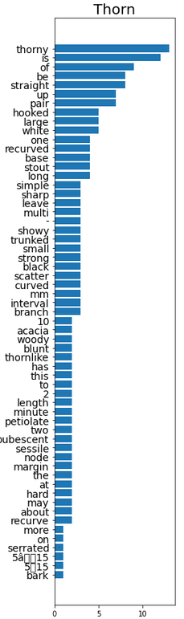
Pierre’s dataset of 360 African trees/bushes and 137 traits
Notes:
It work much better in the case of colours.
There are of course still missing values,
But for the species it does find a colour, it works reasonably well!

Slide 44
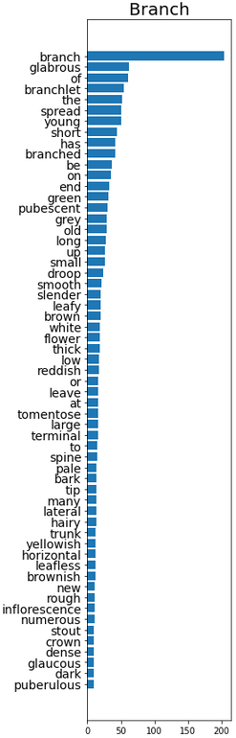
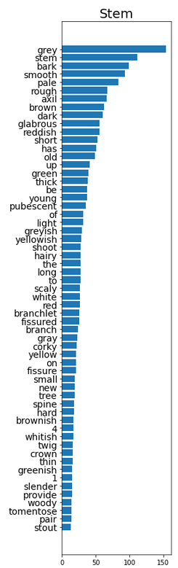
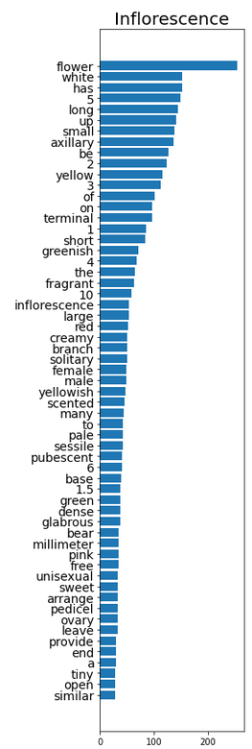
Pierre’s dataset of 360 African trees/bushes and 137 traits
Notes:
It work much better in the case of colours.
There are of course still missing values,
But for the species it does find a colour, it works reasonably well!

Slide 45
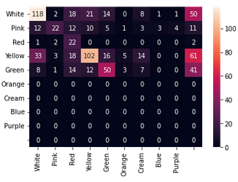
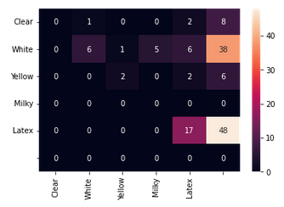
Pierre’s dataset of 360 African trees/bushes and 137 traits
Flower
Actual
Predicted
Latex
Actual
Predicted
Notes:
It work much better in the case of colours.
There are of course still missing values,
But for the species it does find a colour, it works reasonably well!

Slide 46
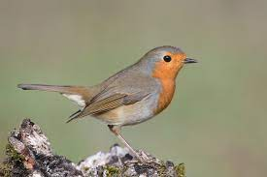
CUB-200 Dataset
Ranking Comparison
Hand-crafted description
Vector similarity
Automatically harvested description
Pre-trained NLP model
Notes:
For the CUB-200 dataset I took another approach.
For each of the 200 birds,
1. I queried the webcrawler and stored the data
2. use the information extraction technique
3. compared and ranked it against all other birds.
4 With a perfect result a diagonal line should be visible.
5 meaning that for e.g. in my own data set, the black crow had a high ranking against the black crow of the CUB dataset.
6 at first sight the results do seem random, but when taking a closer look, there is a small feint diagonal darker line visible.
The complete system does pick up a signal. The overall ranking of the birds is 40.15.
When the model does not pick up anything you expect somehting around a 100.

Slide 47
CUB-200 Dataset
Ranking Comparison
Average Ranking 40.15! (out of 200 ranked birds)
Notes:
For the CUB-200 dataset I took another approach.
For each of the 200 birds,
1. I queried the webcrawler and stored the data
2. use the information extraction technique
3. compared and ranked it against all other birds.
4 With a perfect result a diagonal line should be visible.
5 meaning that for e.g. in my own data set, the black crow had a high ranking against the black crow of the CUB dataset.
6 at first sight the results do seem random, but when taking a closer look, there is a small feint diagonal darker line visible.
The complete system does pick up a signal. The overall ranking of the birds is 40.15.
When the model does not pick up anything you expect somehting around a 100.

Slide 48
Next steps: towards a plant trait ontology?
Organ 3
Trait 1
Trait 3
Organ 2
Stage 1
Trait 2
Trait 4
Organ 1
Notes:
For the CUB-200 dataset I took another approach.
For each of the 200 birds,
1. I queried the webcrawler and stored the data
2. use the information extraction technique
3. compared and ranked it against all other birds.
4 With a perfect result a diagonal line should be visible.
5 meaning that for e.g. in my own data set, the black crow had a high ranking against the black crow of the CUB dataset.
6 at first sight the results do seem random, but when taking a closer look, there is a small feint diagonal darker line visible.
The complete system does pick up a signal. The overall ranking of the birds is 40.15.
When the model does not pick up anything you expect somehting around a 100.

Slide 49
Next steps: towards a plant trait ontology?
Species A
Organ 3
Trait 1
Trait 3
Organ 2
Stage 1
Trait 2
Trait 4
Organ 1
Notes:
For the CUB-200 dataset I took another approach.
For each of the 200 birds,
1. I queried the webcrawler and stored the data
2. use the information extraction technique
3. compared and ranked it against all other birds.
4 With a perfect result a diagonal line should be visible.
5 meaning that for e.g. in my own data set, the black crow had a high ranking against the black crow of the CUB dataset.
6 at first sight the results do seem random, but when taking a closer look, there is a small feint diagonal darker line visible.
The complete system does pick up a signal. The overall ranking of the birds is 40.15.
When the model does not pick up anything you expect somehting around a 100.

Slide 50
Next steps: towards a plant trait ontology?
Species B in stage 0
Organ 3
Trait 1
Trait 3
Organ 2
Stage 1
Trait 2
Trait 4
Organ 1
Notes:
For the CUB-200 dataset I took another approach.
For each of the 200 birds,
1. I queried the webcrawler and stored the data
2. use the information extraction technique
3. compared and ranked it against all other birds.
4 With a perfect result a diagonal line should be visible.
5 meaning that for e.g. in my own data set, the black crow had a high ranking against the black crow of the CUB dataset.
6 at first sight the results do seem random, but when taking a closer look, there is a small feint diagonal darker line visible.
The complete system does pick up a signal. The overall ranking of the birds is 40.15.
When the model does not pick up anything you expect somehting around a 100.

Slide 51
Next steps: towards a plant trait ontology?
Species B in stage 1
Organ 3
Trait 1
Trait 3
Organ 2
Stage 1
Trait 2
Trait 4
Organ 1
Notes:
For the CUB-200 dataset I took another approach.
For each of the 200 birds,
1. I queried the webcrawler and stored the data
2. use the information extraction technique
3. compared and ranked it against all other birds.
4 With a perfect result a diagonal line should be visible.
5 meaning that for e.g. in my own data set, the black crow had a high ranking against the black crow of the CUB dataset.
6 at first sight the results do seem random, but when taking a closer look, there is a small feint diagonal darker line visible.
The complete system does pick up a signal. The overall ranking of the birds is 40.15.
When the model does not pick up anything you expect somehting around a 100.

Slide 52
Next steps
Next steps
Clean irrelevant information (Glossary?)
Homogenize traits across species (Synonyms?)
How to deal with comparisons?
Notes:
The second part was to extract the most relevant traits
From the sentences

Slide 53
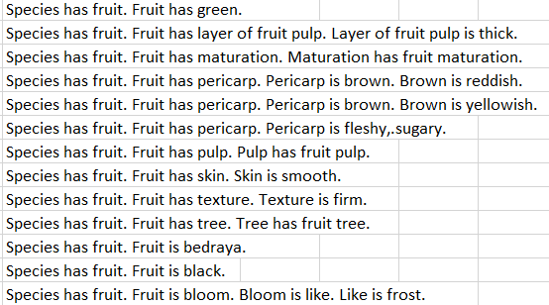
Better data extraction
Next steps
Supervised with existing curated databases
Notes:
The second part was to extract the most relevant traits
From the sentences

Slide 54
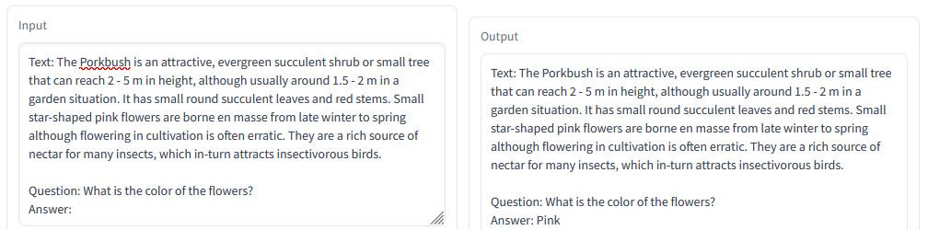
Better data extraction
Next steps
https://huggingface.co/spaces/huggingface/bloom_demo
Notes:
The second part was to extract the most relevant traits
From the sentences

Slide 55
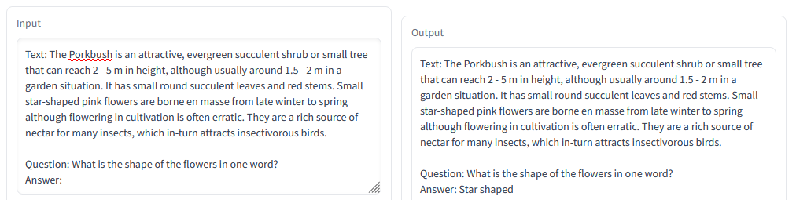
Better data extraction
Next steps
https://huggingface.co/spaces/huggingface/bloom_demo
Notes:
The second part was to extract the most relevant traits
From the sentences

Slide 56
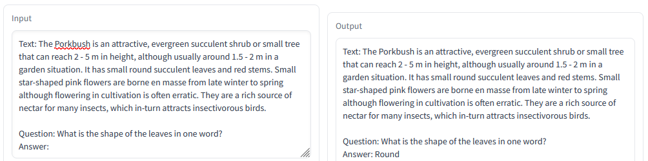
Better data extraction
Next steps
https://huggingface.co/spaces/huggingface/bloom_demo
Notes:
The second part was to extract the most relevant traits
From the sentences

Slide 57
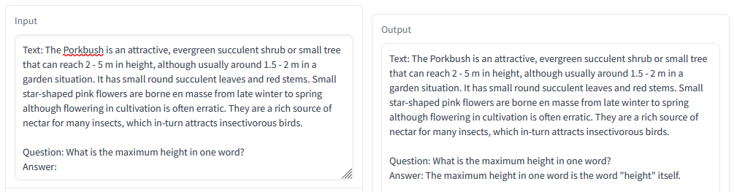
Better data extraction
Next steps
https://huggingface.co/spaces/huggingface/bloom_demo
Notes:
The second part was to extract the most relevant traits
From the sentences

Slide 58
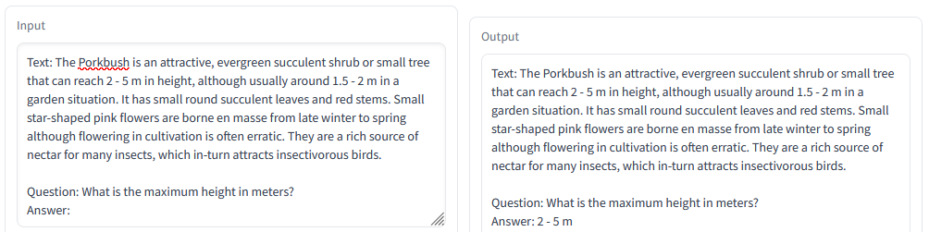
Better data extraction
Next steps
https://huggingface.co/spaces/huggingface/bloom_demo
Notes:
The second part was to extract the most relevant traits
From the sentences

Slide 59
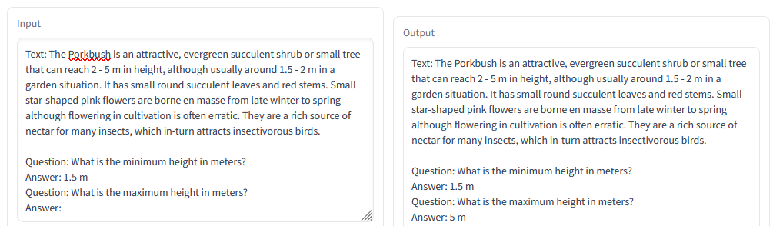
Better data extraction
Next steps
https://huggingface.co/spaces/huggingface/bloom_demo
Notes:
The second part was to extract the most relevant traits
From the sentences

Slide 60
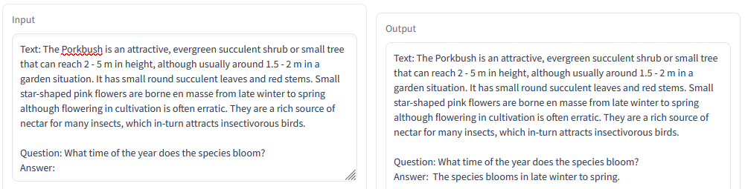
Better data extraction
Next steps
https://huggingface.co/spaces/huggingface/bloom_demo
Notes:
The second part was to extract the most relevant traits
From the sentences

Slide 61
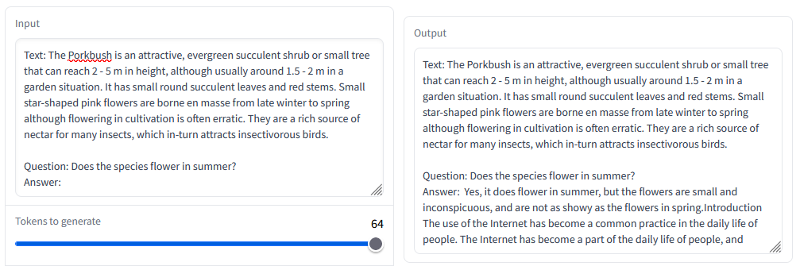
Better data extraction
Next steps
https://huggingface.co/spaces/huggingface/bloom_demo
Notes:
The second part was to extract the most relevant traits
From the sentences

Slide 62
Visual-text Hybrid model
Next steps
How to train this? We only have a class label per image!
Simple leaves
Alternate leaves
Toothed lobes
Sharp lobes
Lustrous leaves
40% Q. rubra
27% Q. ilex
...
Notes:
The second part was to extract the most relevant traits
From the sentences

Slide 63
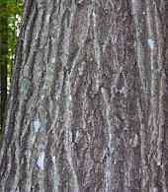
Visual-text Hybrid model
Next steps
Simple leaves
Alternate leaves
Toothed lobes
Sharp lobes
Lustrous leaves
Standard captioning task
Scaly bark
Dark reddish gray
Smooth when young
Notes:
The second part was to extract the most relevant traits
From the sentences

Slide 64
Visual-text Hybrid model
Next steps
Simple leaves
Alternate leaves
Toothed lobes
Sharp lobes
Lustrous leaves
Q. rubra
Our supervision is much weaker!
Scaly bark
Dark reddish gray
Smooth when young
Etc.
Etc.
...
Q. rubra
Notes:
The second part was to extract the most relevant traits
From the sentences

Slide 65
Conclusion
The ingredients seem feasible:
  Building a coherent database of species descriptions
  Training a vision deep learning model with a trait bottleneck
Let’s cook a visual-language model that works like a botanist!
Notes:
The second part was to extract the most relevant traits
From the sentences

Slide 66
Lots of work ahead!
Thank you!
Notes:
To extract information from sentences I tried several techniques.
I compared the results of each technique against the CUB-200 dataset
The CUB 200 dataset contains 200 different birds with hand annotated imaged.
I only use the text annotations to give each bird a set of traits
I trained a species classifier on 2000 species and made sure the CUB species were present in the data
These techniques are all posthoc attribution techniques,
except PoS. PoS uses pre trained transformer based networks to tag all the words and relations in a sentence.

